Slide 1
Getting Ready for Canadian Computing Competition
Class classNum.size() - 1
February 7, 2020

Slide 2
Reading Input
Read your input in main to avoid dangling pointers
Except for trees, use the heap (new Node)
4 ways:
Given size – for-loop
Not given size but are all the same – while(cin >> n)
Not given size but contain different types – sstream
Reading in different types (type conversion, stoi, or cin.ignore(), cin.clear())

Slide 3
Useful Skills
Operator overloading
Especially operator< for both sort and map
Writing class methods
Use of this->
Kruskal’s algorithm
Union-find algorithm
Path compression

Slide 4
Ternary Operator
Syntax:
var = (Boolean_Expression) ? True_Case : False_Case;
Equivalent to :
if (boolean_Expression) {
True_case;
} else {
False_case;
}
Example:
Declare an integer, maxVal, to be the max of two given integers, n1 and n2.
Solution:
int maxVal = (n1 > n2) ? n1 : n2;

Slide 5
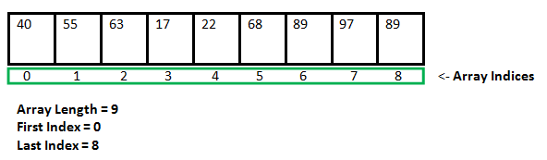
Arrays
The indices span from 0 to n – 1
You can initialize an array:
int foo1 [3] = {16, 2, 77};
int foo2 [3] = {16, 2}; // {16, 2, 0};
int foo3 [3] = {}; // {0, 0, 0}
If fewer values than the array size is provided, the array is filled from the beginning. The rest are filled with the "zero" of the base array type
Array Base Type | “Zero” Value
Int | 0
Bool | 0 (false)
String | “” (empty)

Slide 6
Vectors
Arrays are static
They have a fixed size
Dynamic arrays can grow and shrink in size
Vectors have a base type and a collection of base type values

Slide 7
Vectors
Declaration Syntax:
#include <vector> // at top of the file, use C++14
vector<Base_Type> vecName;
Ex). Vector of ints: vector <int> myIntVect;
Initialize the vector: vector <int> myIntVect = {1,2,3};

Slide 8
n-Dimensional Vectors
Declaration:
vector <vector<int>> my2dVect = {1,2,3};
Adding a row:
my2dVect.emplace_back (vector<int>()); // note the parenthesis

Slide 9
Vector Operations
vec[pos] – gets the element at index pos
if pos is out of range, it will cause a run time error
Same as an array
vec.push_back(x) or vec.emplace_back(x) for C++14 and later
x must be the base type, otherwise it will cause a compilation error
adds x to the end of vec

Slide 10
Vector Operations
vec.back() – gets the last element in the vector
vec.front() – gest the front of the vect, same as vec[0]
Vec.pop_back() – removes the last element in the vector

Slide 11
More Vector Operations
vec.size() - returns number of elements in vec
vec.clear() - removes all elements from vector and leave the vector with a size of 0
vec.erase(startPos, endPos) - removes element from startPos (inclusive) to endPos (exclusive)
must use iterator

Slide 12
Vector Iterators
vec.begin() – iterator for beginning of vector (like a pointer)
vec.end() – iterator for end of vector (like a pointer)
only use iterator for vec.erase(start, end) for now
Element 1
Element 2
…
Element n
Iterator.begin()
Iterator.end()

Slide 13
Function Overloading
You are overloading a function if the new function share the same name as an excising function
These two functions must have different function signatures
Function signature – number , order, and type of parameters
The compiler is smart enough to figure out which function you are calling as long as you have different function signatures
Otherwise it will not let you compile

Slide 14
Default Arguments
When calling, you can only use default values at the end of the function
You cannot selectively use some default values while skipping over others
Ex). For the function int foo (int a = 0, int b = 0, int c = 0);
foo() // valid
foo (1) // valid, a = 1, b = default, c = default
foo (1,2) // valid, a = 1, b = 2, c = default
foo(1,2,3) // valid, a = 1, b = 2, c = 3
foo (1,,3) // invalid, you are trying to call with a = 1, b = default, c = 3
foo(,,1) // invalid, you are trying to call with a = 0, b = default, c = 1
! Accumulative recursion’s starting values can be set using default arguments

Slide 15
Bubble Sort
void bubbleSort(vector <int> arr, int n) {
bool swapped;
for (int i = 0; i < n-1; i++) {
for (int j = 0; j < n-i-1; j++) {
swapped = false;
if (arr[j] > arr[j+1]) {
swap(arr[j], arr[j+1]); // or swap(&arr[j], &arr[j+1]);
swapped = true;
}
}
if (!swapped) break;
}
}

Slide 16
<algorithm> - sort
There is a built- in sort function in C++ STL
Include <algorithm> as header
Sort (iterator start_loc, iterator end_loc[ ,compare])
Sorts from [start_loc, end_loc)
End_loc must be recheable from start_loc by incrementing start_loc
Compare is optional and has default operator<

Slide 17
Recursion
A function calls itself repeatedly until a base case is encountered
A recursive function always contains:
A base case (when the parameter reaches a certain value)
A recursive call (falling the function itself with updated parameters)
You can obtain your result in 2 days:
By return value → structural recursion
By an accumulator which will be the final value at the end → accumulative recursion

Slide 18
Creating a Structure
Syntax:
struct structureName{
member1Type member1Name;
member2Type member1Name;
…
membernType membernName;
};

Slide 19
Constructor
Terminology:
When a struct is defined, no memory is allocated.
When a structure is declared, memory is allocated. We call this an object or instance of the class
When an object is created, the constructor is called
If we do not write a constructor, the C++ compile generates two default constructors for us
Once we write our own, we lose the default constructors

Slide 20
Constructor
Constructor has same name as the struct itself
Constructors do not have return type because it is the object itself
Example:
struct Student {
string name;
int student_num, grade;
};
int main() {
Student s1; // default constructor
Student s2{"Jasmine", 1, 99}; // default constructor
}

Slide 21
Calling a Constructor
Use round braces!
Node temp {…};
Node *temp1 = new Node {…};

Slide 22
Simplifying the Constructor - MIL
Member Initialization List
Syntax: Constructor (parameters) : field_name1 {value from parameter}, field_name2 {value2} ,… field_namen {valuen} { body }
You can leave out any field name and it will be filled with default values
int counter = 0;
struct Student {
string name;
int student_num, grade;
Student (string name) : name {name}, grade{0}, student_num {counter} {
++counter;
}
};

Slide 23
Pointers
variables are locations in computer memory which can be accessed by their identifier (variable name)
Each variable can be located in the memory by its address

Slide 24
Address-of operator (&)
address-of operator (&) obtains the address of a variable
address-of operator (&) is applied to whatever precedes it
Example:
foo = &myvar; foo now contains the address of myvar

Slide 25
Dereference operator (*)
We can use a pointer to access the variable they point to
dereference operator (*) means "value pointed to by“
It will get the value of whatever pointer precedes it
If what precedes is not a pointer, ERROR (syntax error)
Ex). fooVal = *foo;
// "fooVal equal to value pointed to by foo where foo is a pointer”
fooVal = foo; // fooVal is a pointer
fooVal = *foo; // fooVal equal to value pointed to by foo (25)

Slide 26
Null Pointers
pointers are meant to point to valid addresses
uninitialized pointers can point to unknown places
Example
int *p;
cout << *p << endl; // you don’t know what this will print
Accessing this pointer causes undefined behavior
If you want a pointer to point to nowhere, we use the null pointer (0 or nullptr)
int *p = nullptr; // recommend nullptr over 0
int *q = 0;

Slide 27
Pointer Arithmetic
We can also do + and – operations on pointers
+ moves it to the next element
- moves the pointer to the previous element
Out of bounds? Adding numbers to an int pointer?

Slide 28
const Keyword Examples
const int a = 0; // a is a constant integer, const -> a
int const a = 0; // a is a constant integer, const -> a
const int *p = &a; // p points to a constant integer
*p is constant (you cannot modify a through p)
p itself is not constant
int * const p = &a; // p is a constant pointer
*p can be modified
p cannot point to something else

Slide 29

Dangling Pointers
When a pointer points to something that does not exist
A variable that goes out of scope
Unpredictable behaviour
Example:
int * foo () {
int a = 1;
return &a;
}
int main() {
int * dangling_pointer = foo();
cout << *dangling_pointer << endl; // unpredictable behaviour
}

Slide 30
Call Stack
int bar(int a) {
return a;
}
int foo() {
int b = 10;
int c = bar(b);
return c;
}
int main() {
int a = 2;
int b = 3;
a = foo();
a = 12;
return 0;
}
A stack keeps track of all local variables and arguments supplied to the function.

Slide 31
Range Based for-loop
Executes a for loop over a range of values
Syntax:
for ( range_declaration : range_exp ) {…}
range_declaration defines that variable that is the type in the range_exp
Example:
for (auto i : {1,3,5}) { // auto detection of type
cout << i ;
}
// prints 1 3 5

Slide 32
Lvalue References
Other than pointers, we can use an lvalue reference to keep track of memory addresses
Lvalues do not store memory addresses
They are aliases
They are “different names” of the same variable
They must be initialized at declaration
Declaration syntax:
Type & name = variable;

Slide 33
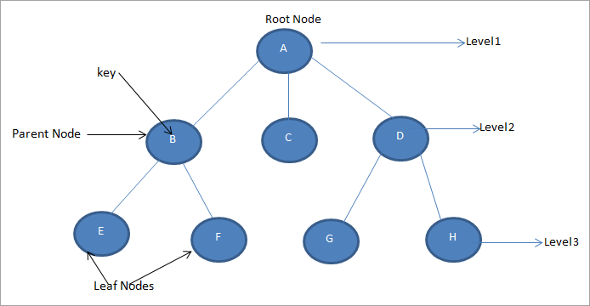
Tree Terminology
Node
Edge – connecting two nodes
Key
Level
Root Node - topmost node
Leaf node - Bottom most nodes
Sibling nodes – two nodes on the same level

Slide 34
Tree Terminology
Subtree – descendants of a node from another node
Parent node
Ancestor node – predecessor node on path from root
The root node has no ancestors and no parent
Path – sequence of consecutive edges
Degree – number of children that a node has

Slide 35
Representing a Binary Tree
A structure can never contain a field of itself
But we can contain a pointer! Pointers are always 4 bytes
struct Node {
int val;
Node *left, *right;
};

Slide 36
Heap
A pool of memory for dynamic memory allocation
You should return all burrowed memory at the end of execution
Otherwise it will cause a memory leak
Good news …
The “new” keyword allocates memory from the heap
Syntax: new data_type (or data_type {…} which calls its constructor)
Returns a pointer to the allocated memory

Slide 37
Node Constructors
Node (int val) : val{val}, left {nullptr}, right{nullptr} {}
Node () {} // recover default constructor so you can write
// Node *temp;
Node (int val, Node *left, Node *right) : val{val}, left{left}, right{right} {} // so you can call new inside new

Slide 38
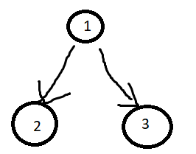
Exercise – Using the Heap
Given the Node struct and its constructor, create the following tree on the heap (in main)
Node *root = new Node {1};
root->left = new Node {2};
root->right = new Node {3};
struct Node {
int val;
Node *left, *right;
Node (int val) : val{val}, left {nullptr}, right{nullptr} {}
Node (int val, Node *left, Node *right) : val{val}, left{left}, right{right} {}
};
Node *root = new Node {1, new Node {2}, new Node {3}};

Slide 39
Tree Traversal
Traversing a tree means visiting the nodes of a tree
There are many ways to visit trees:
Breadth first / level order
Depth first (next class)
Inorder
Preorder
postorder

Slide 40
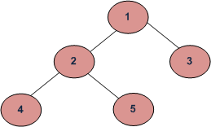
Level Order Traversal
Left to right
Visit all sibling nodes at the present depth before moving on to the next left
Example: 1 2 3 4 5

Slide 41
Iterative Approach
Node * makeTree (const vector <Node *> &tempVal, int n) {
int leftLoc, rightLoc;
for (int i = 0; i < n; ++i) {
leftLoc = 2 * i + 1;
rightLoc = 2 * i + 2;
if (leftLoc < n) {
tempVal[i]->left = tempVal[leftLoc];
}
if (rightLoc < n) {
tempVal[i]->right = tempVal [rightLoc];
}
}
return tempVal[0];
}

Slide 42
Iterative Approach Main Function
int main() {
int n, input;
cin >> n;
vector <Node *> tempVal;
for (int i = 0; i < n; ++i) {
cin >> input;
tempVal.emplace_back (new Node {input});
}
Node *root = makeTree(tempVal, n);
}

Slide 43
Recursive Approach
Node * makeTree (const vector <int> &tempVal, int n, int i = 0) {
if (i < n) {
Node *temp = new Node{tempVal[i]};
temp->left = makeTree(tempVal, n, 2 * i + 1);
temp->right = makeTree(tempVal, n, 2 * i + 2);
return temp;
}
else {
return nullptr;
}
}

Slide 44
Recursive Approach Main Function
int main() {
int n, input;
cin >> n;
vector <int> tempVal;
for (int i = 0; i < n; ++i) {
cin >> input;
tempVal.emplace_back (input);
}
Node *root = makeTree(tempVal, n);
printTree(root);
return 0;
}

Slide 45
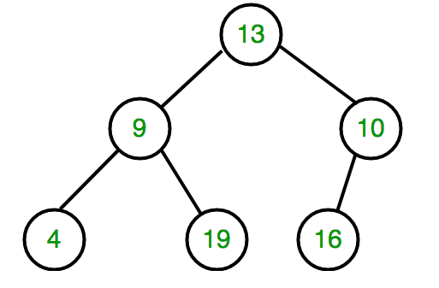
Level Order Traversal
Vector contains {10, 4, 19}
Get 10, remove from vect, add its children
Vector contains {4, 9, 16}
Get 4, add its children (none)
Get 19 (no children added to vector)
Get 16 (no children added to vector)

Slide 46
Queue
We used the vector as a queue
First in first out
The vector would require: vec.erase(vec.begin(), vec.begin()+1), vec.emplace_back(x)
There is an STL for it: Queue

Slide 47
Queue
Header: #include <queue>
Declaration syntax: queue <type> queueName;
empty() – Returns a bool indicating whether the queue is empty
size() – Returns the size of the queue
front() – get first element of the queue
back() – get last element of the queue
push(x) – adds x at the end of the queue (x must match specified type)
pop() – deletes the first element of the queue

Slide 48
Practice – Level Order Traversal Solution
void printLevelOrderTree (Node *p, queue<Node *> &tempNodes) {
cout << p->val << endl;
if (p->left) { // avoid nullptr
tempNodes.push(p->left);
}
if (p->right) {
tempNodes.push(p->right);
}
if (!tempNodes.empty()) {
Node * newP = tempNodes.front();
tempNodes.pop();
printLevelOrderTree(newP, tempNodes);
}
}

Slide 49
Depth First Traversal
visit all subtrees in one direction before visiting the next direction
involves visiting root, left, then right
Preorder: root – left – right
Inorder: left – root – right
Postorder: left – right – root
“order” == root

Slide 50
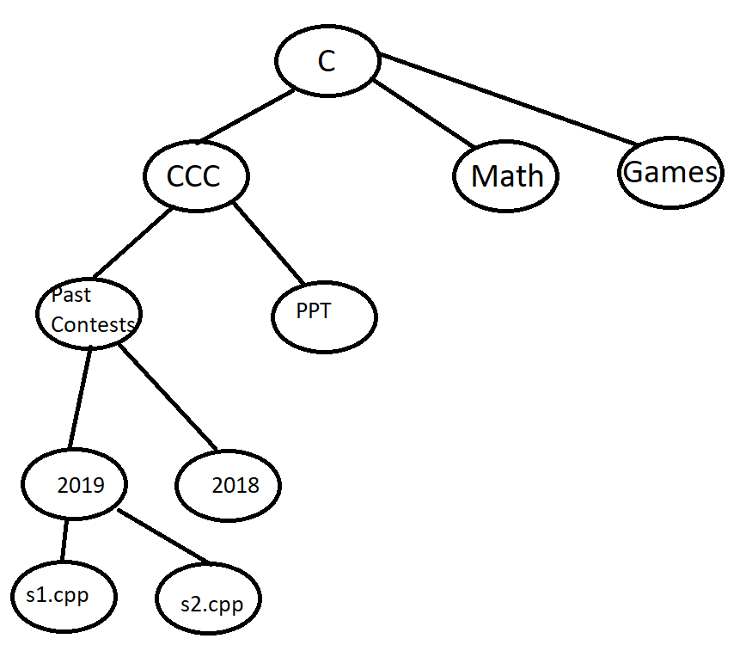
Application – File Directories
preorder: root-left-right
Copying a directory
You want to copy the director/folder first before copying its contents
Inorder: left-root-right
Display contents (assuming your tree is already sorted)
Postorder: left-right-root
Remove a directory
Empty child directories before deleting the root

Slide 51
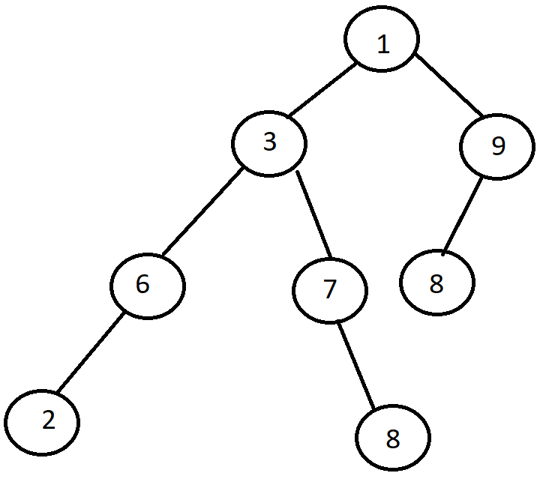
Preorder Traversal
Print a tree in preorder traversal.
This should print:
1 3 6 2 7 8 9 8

Slide 52
Inorder Traversal
Print a tree in inorder traversal.
What should this print?
2 6 3 7 8 1 8 9

Slide 53
Postorder Traversal
Print a tree in postorder traversal.
What should this print?
2 6 8 7 3 8 9 1

Slide 54
Tree Traversal Using Iteration - Stack
Preorder
Recall how we used a queue for level order traversal
Recursion is highly recommended for inorder and postorder

Slide 55
Stack
Declaration: stack<type> stackName;
S.empty()
S.size()
S.top() – gets top of stack
S.push(x) – places x on top of stack
S.pop() – removes the element on top

Slide 56
Kruskal’s Algorithm
Used for connecting a graph

Slide 57
Kruskal’s Algorithm
Used for connecting a graph
How do we check that it forms a cycle?
Union-find algorithm
Optimization: path compression

Slide 58
STL Map
#include <map>
Declaration: map <type1, type2> mapName;
Adding elements: mapName.insert (pair <type1, type2> (val1, val2))
Using type1 as an index: mapName[type1]
If type1 does not exist, this action will add type1 into the map as an index. Val2 will contain 0 of its type
You can also use this to insert values
mapName.size()
mapName.empty()
When inserting into a map, the operator< is implicitly called

Slide 59
Range-based For-loop
We use the keywords first and second to denote the map
for (auto i: myMap) {
cout << i.first << “ “ << i.second << endl;
}

Slide 60
84 104 101 32 101 110 100 33 32 71 111 111 100 32 108 117 99 107 33 32

Slide 61


